Slide 1
QR Code Reader Optimization for Low Resource Embedded System
Speaker : NTU BIME - Yitse Wu
Advisor : Daming Chiang
Company : Upbeat Technology

Slide 2
1. Introduction
Outline
2. Material and Methods
QR Code / Purpose
RPi / ZXing / Valgrind
3. Results
4. Conclusion
Peak Memory / Comparison
Conclusion
Notes:
sudo g++ "%f" -o %e `pkg-config --cflags --libs zxing`

Slide 3
Introduction
Notes:
sudo g++ "%f" -o %e `pkg-config --cflags --libs zxing`

Slide 4
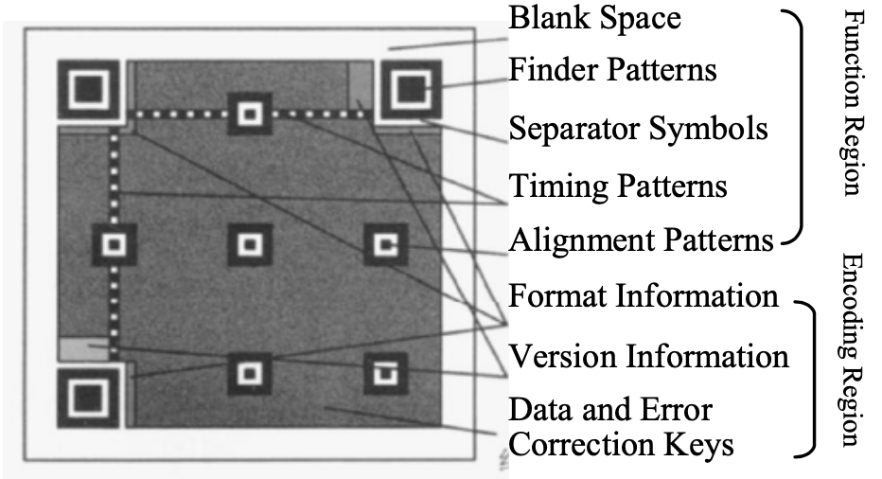
Introduction to QR Code
Finder pattern
Alignment Pattern
Timing Pattern
Timing Pattern :
Determine density and version of QR Code symbol, and providing the reference position
Notes:
sudo g++ "%f" -o %e `pkg-config --cflags --libs zxing`

Slide 5
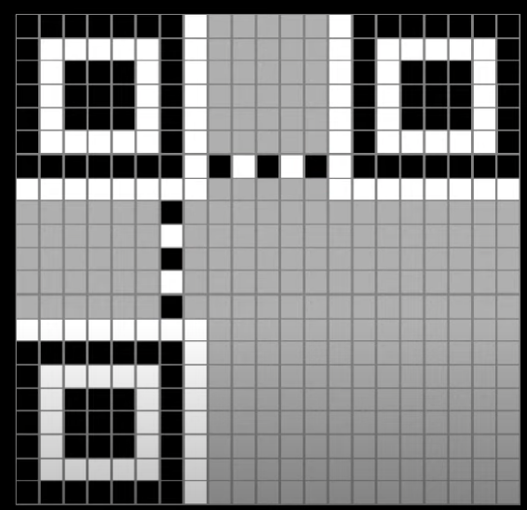
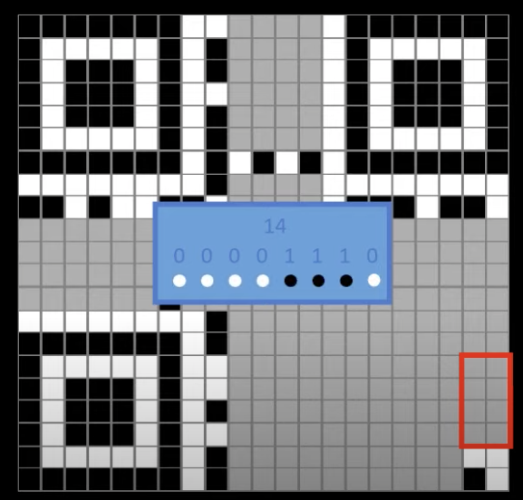
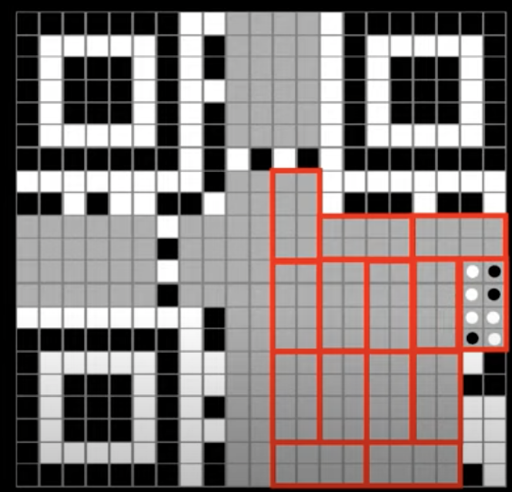
Introduction to QR Code
(A)
(B)
(C)
Notes:
sudo g++ "%f" -o %e `pkg-config --cflags --libs zxing`

Slide 6
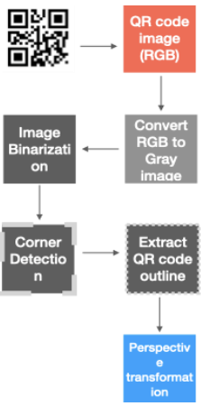
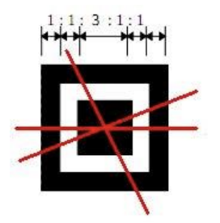

Introduction to QR Code
Localization
Pre-processing
After detection of a QR code, its image is processed to make it suitable for optimal and accurate decoding. This step is commonly called pre-processing. Due to the real world applications of the QR code, pre-processing becomes vital to not only enhance the accuracy of decoding but also to make it faster and simpler.
Detection and localization of a QR code are essential and the first-step in the workflow of using them and retrieving information.
Notes:
sudo g++ "%f" -o %e `pkg-config --cflags --libs zxing`

Slide 7


Purpose
QR Code Reader
Low Resource
Read Image
Localization, Pre-processing …
Low Peak Memory
Small Execution Time
Notes:
sudo g++ "%f" -o %e `pkg-config --cflags --libs zxing`

Slide 8
Material and Methods
Notes:
sudo g++ "%f" -o %e `pkg-config --cflags --libs zxing`

Slide 9
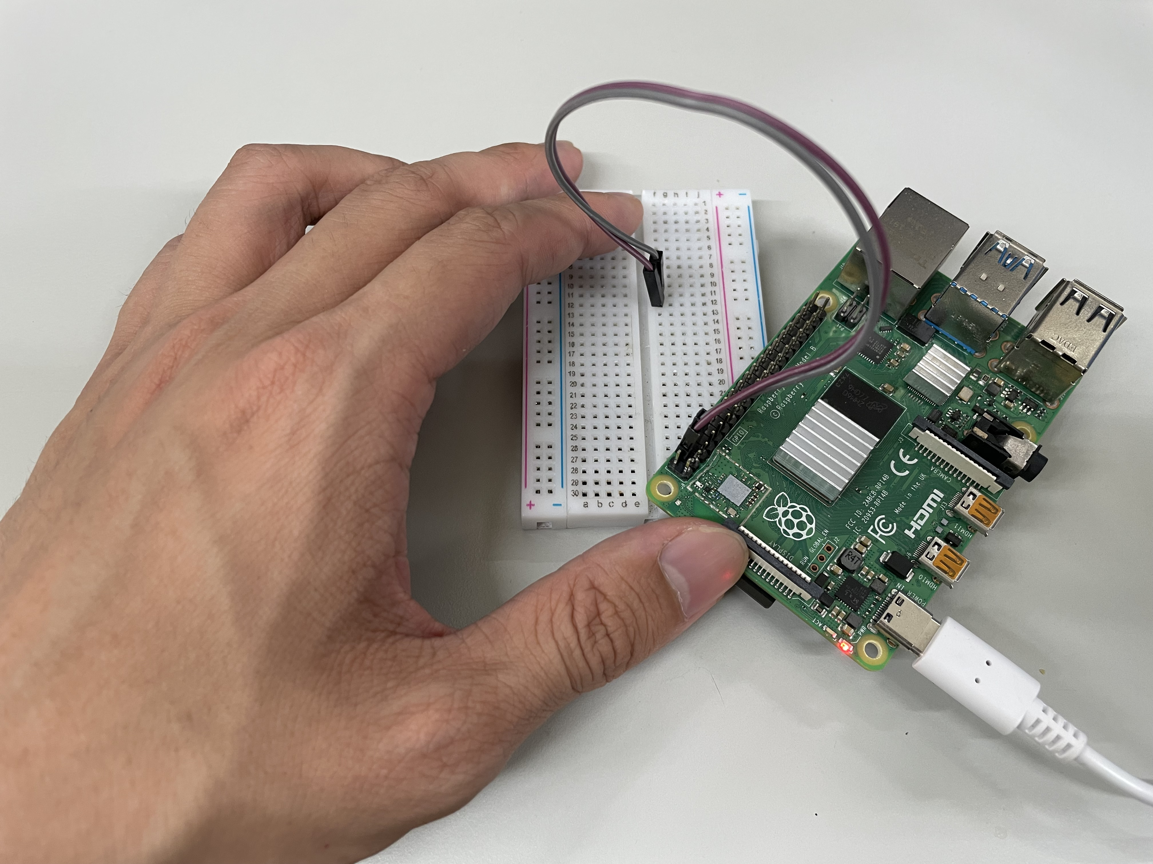

Material : Raspberry Pi and QR Code
Raspberry Pi 4
328 * 328 QR Code
Notes:
sudo g++ "%f" -o %e `pkg-config --cflags --libs zxing`

Slide 10
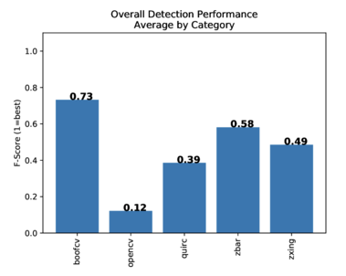
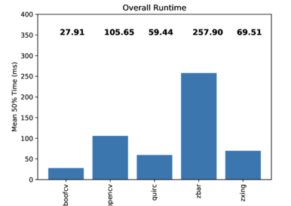
Open Source Performance Comparison
Notes:
sudo g++ "%f" -o %e `pkg-config --cflags --libs zxing`

Slide 11
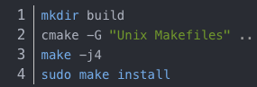
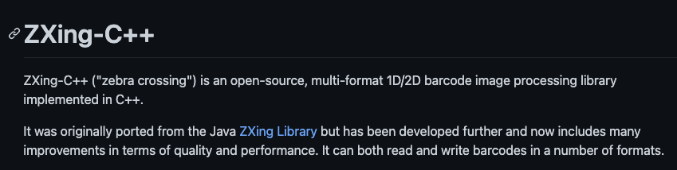
ZXing
https://github.com/nu-book/zxing-cpp
Notes:
sudo g++ "%f" -o %e `pkg-config --cflags --libs zxing`

Slide 12
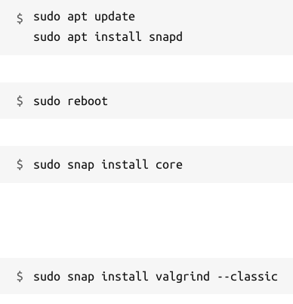
Valgrind
Valgrind is an instrumentation framework for building dynamic analysis tools. There are Valgrind tools that can automatically detect many memory management and threading bugs, and profile your programs in detail. You can also use Valgrind to build new tools.
Introduction
Installation
Command
valgrind --tool = SelectTool ./ReadQrcode_V1
Tool :
memcheck : Memory Error and Memory Leak
massif : Stack + Heap
Notes:
sudo g++ "%f" -o %e `pkg-config --cflags --libs zxing`

Slide 13
Results
Notes:
sudo g++ "%f" -o %e `pkg-config --cflags --libs zxing`

Slide 14
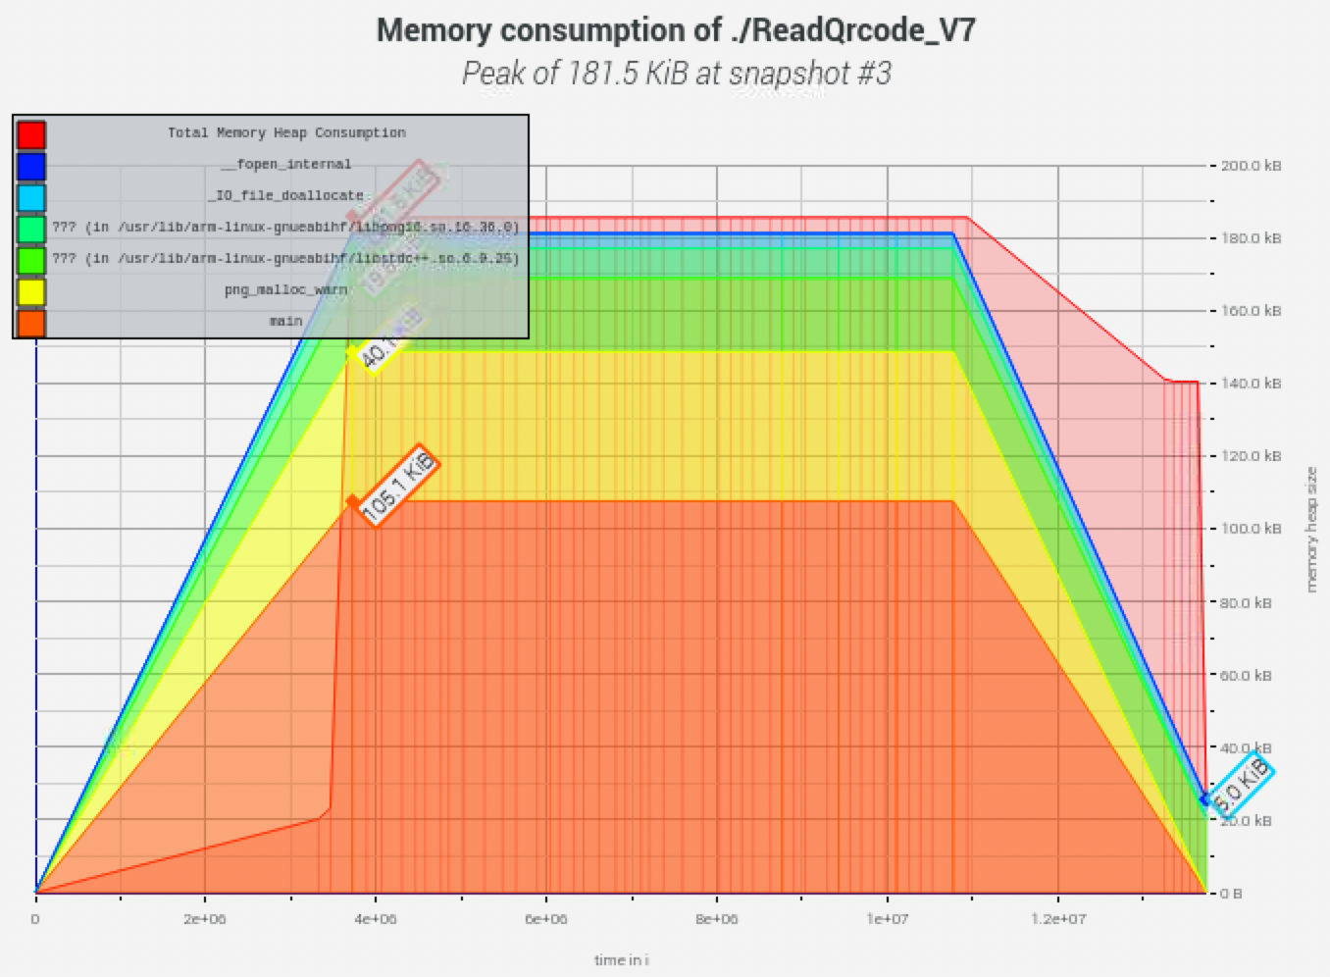
Peak Memory
Use Valgrind to estimate
memory usage
Peak memory : 181.5 KB
Use libpng reading image
open Source
Notes:
sudo g++ "%f" -o %e `pkg-config --cflags --libs zxing`

Slide 15
Comparison
Version | 1 | 2 | 3 | 3_ | 4 | 5 | 6 | 7
Peak Memory | 554.6 KB | 552.6 KB | 552.7 KB | 242.9 KB | 977.4 KB | 915.4 KB | 182.5KB | 181.5 KB
Img Channels | 3 | 3 | 3 | 1 | 3 | 3 | 1 | 1
Time | 0.039 s | 0.026 s | 0.028 s | 0.029 s | 0.060 s | 0.030 s | 0.037 s | 0.029 s
Read Img Method | stb | stb | stb | stb | lodepng | Cimg | libpng | libpng
Notes:
sudo g++ "%f" -o %e `pkg-config --cflags --libs zxing`

Slide 16
Conclusion
Notes:
sudo g++ "%f" -o %e `pkg-config --cflags --libs zxing`

Slide 17
Conclusion
Implement a program that use low memory
Use 181.5 KB to decode a 328*328 QR code image
Learn the open source code reading ability
Learn the usage of Zxing / Valgrind / libpng / stb ……
Notes:
sudo g++ "%f" -o %e `pkg-config --cflags --libs zxing`

Slide 18
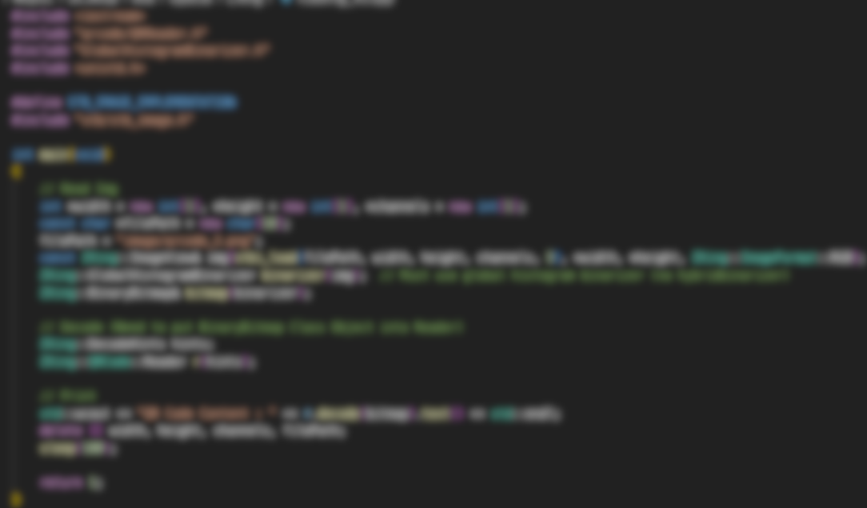
Thank you
Notes:
sudo g++ "%f" -o %e `pkg-config --cflags --libs zxing`

